Slide 1
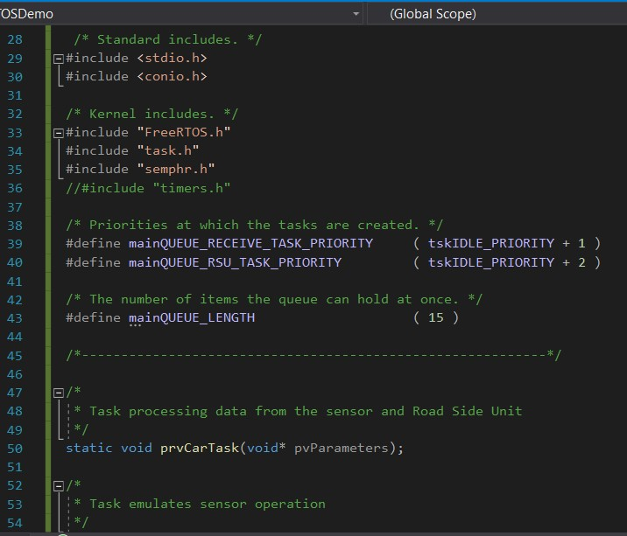
Priority declaration

Slide 2
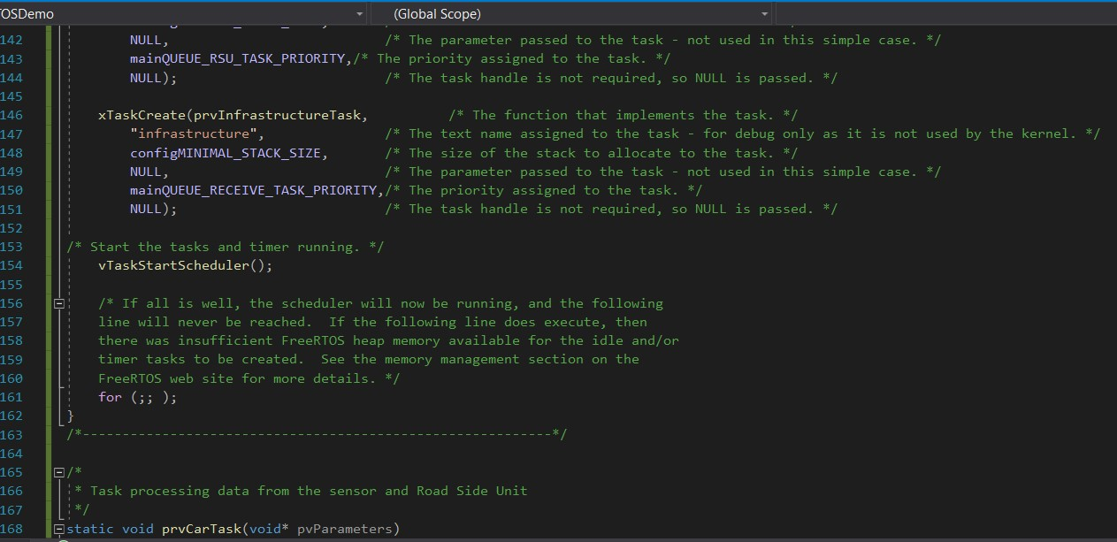
Scheduler

Slide 3
Genetic Algorithm
1) Randomly initialize populations p
2) Determine fitness of population
3) Until convergence repeat:
a) Select parents from population
b) Crossover and generate new population
c) Perform mutation on new population
d) Calculate fitness for new population

